Slide 1
Logistic Regression
Tim Pengajaran
Mata Kuliah Machine Learning
Jurusan Teknologi Informasi Tahun 2021

Slide 2
Disclaimer
This presentation material, including examples, images, references are provided for informational and explanation assistance only
The names of actual products and companies mentioned here in, if any, may be the trademarks of their respective owners
Credits shall be given to the images taken from the open-source and cannot be used for promotional activities

Slide 3
Outline Logistic Regression
What is Logistic Regression?
Binary Classification
Tuning Models with Grid Search
Multi-class Classification
Multi-label Classification and Problem Transformation

Slide 4
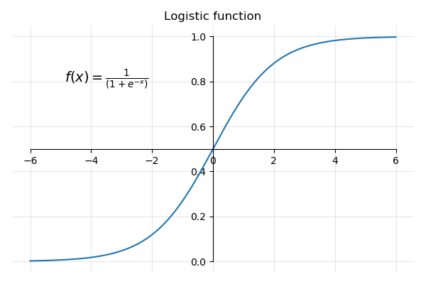


What is Logistic Regression?
A function that models the exponential growth of a population.
Firstly proposed by Pierre François Verhulst (1804-1849).
Logistic Function is used for prediction.
$$Q\left(t\right)=\frac{1}{1+e^{−t}}$$
$Q\left(t\right)$ is the variable that increases with time and is a fraction between 0 and 1.
$t$ stands for time in most cases.
$e$ is a constant called Euler’s number.
$$Q\left(t\right)=\frac{1}{1+e^{−t}}$$

Slide 5
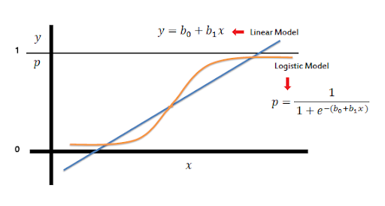
What is Logistic Regression?
Generalized model of Linear Regresion
Used for classification tasks – induces a function that maps an observation to its associated class or label
The learning algorithm must use pairs of feature vectors and their corresponding labels to induce the values of the mapping function's parameters that produce the best classifier, as measured by some performance metric.

Slide 6
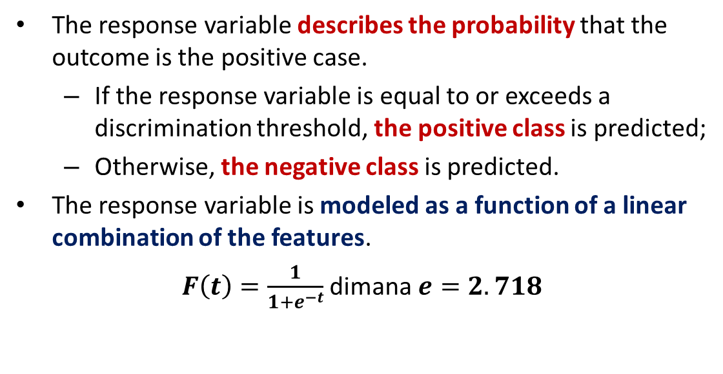
Logistic Regression
The response variable describes the probability that the outcome is the positive case.
If the response variable is equal to or exceeds a discrimination threshold, the positive class is predicted;
Otherwise, the negative class is predicted.
The response variable is modeled as a function of a linear combination of the features.
$F\left(t\right)=\frac{1}{1+e^{−t}}$ dimana $e=2.718$

Slide 7
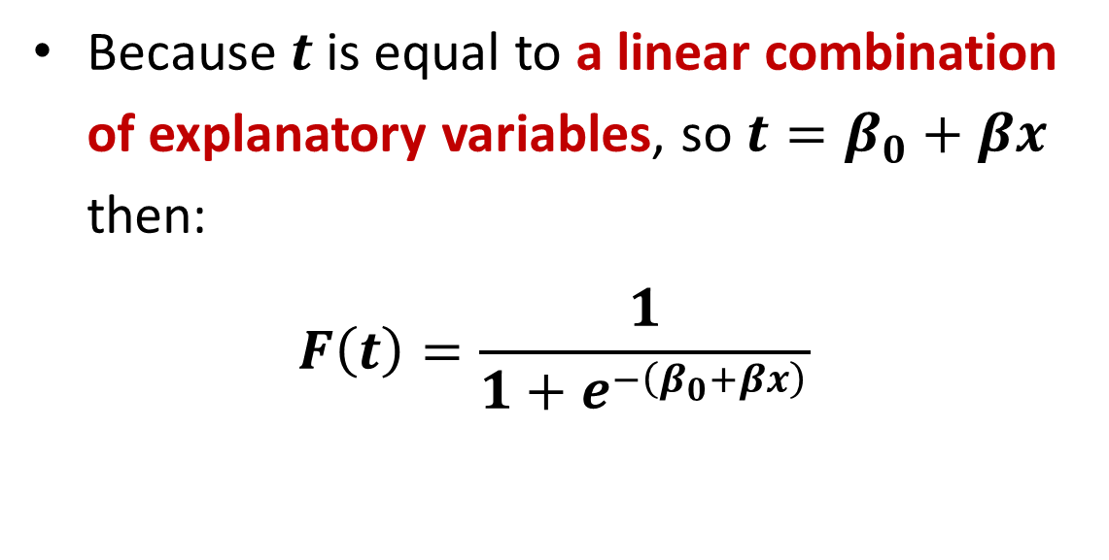
Logistic Regression
Because $t$is equal to a linear combination of explanatory variables, so $t=β_{0}+βx$ then:
$$F\left(t\right)=\frac{1}{1+e^{−\left(β_{0}+βx\right)}}$$

Slide 8
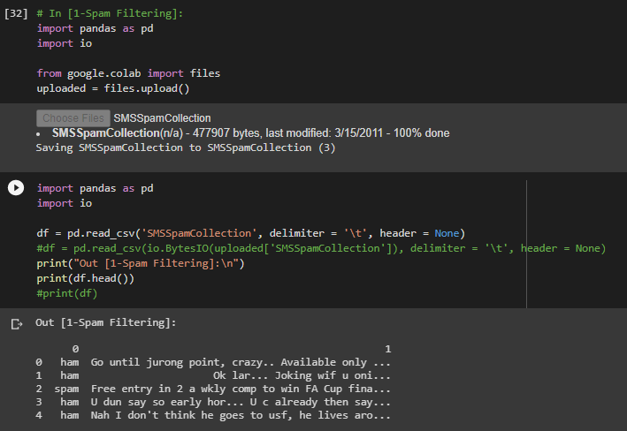
Binary Classification – Spam Filtering
In this case, the model predicts whether the predicted class was correct or not (spam or ham).
The performance metrics used for linear regression are inappropriate for this task.
There will be no boundary decision.

Slide 9
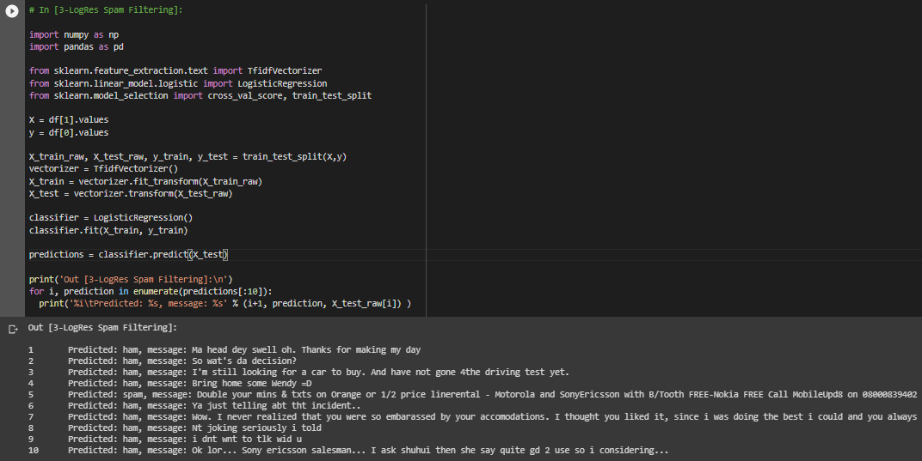
Binary Classification – Spam Filtering

Slide 10
Binary Classification Performance Metrics
Accuracy.
Precision.
Recall.
F1 Measure.
ROC AUC score.
All of these measures depend on the concept of true positives, true negatives, false positives, and false negatives.
Positive and negative refer to the classes.
True and false denote whether the predicted class is the same as the true class.

Slide 11
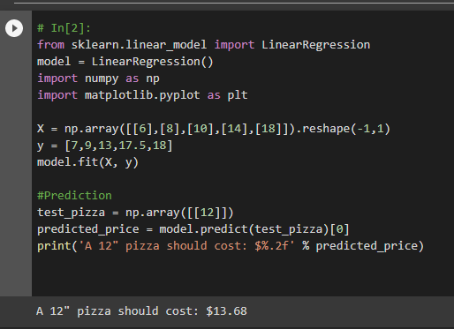
Performance Metrics
For SMS spam classifier
A true positive prediction is when the classifier correctly predicts that a message is spam.
A true negative prediction is when the classifier correctly predicts that a message is ham.
A prediction that a ham message is spam is a false positive prediction.
A spam message incorrectly classified as ham is a false negative prediction.

Slide 12
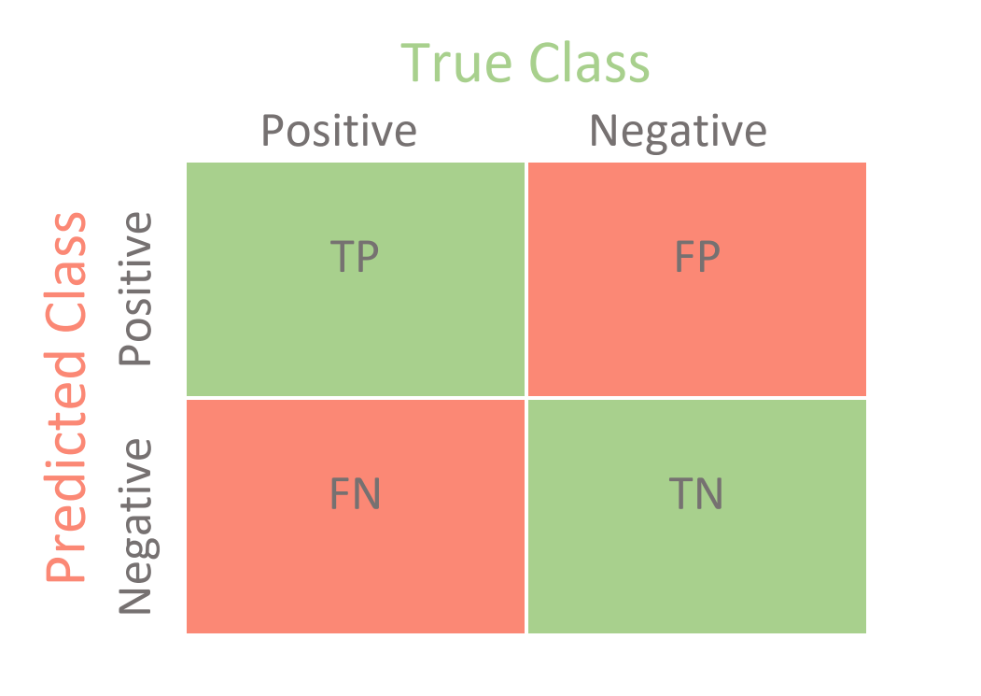
Confusion Matrix
Can be said as contingency table
Use to visualize true and false positives and negatives.
The rows of the matrix are the true classes of the instances.
The columns of the matrix are the predicted classes of the instances.

Slide 13
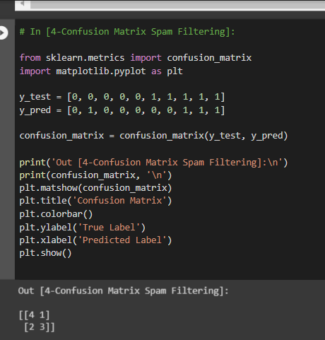
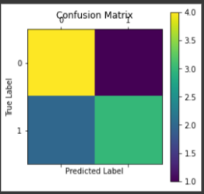
Confusion Matrix for Spam Filtering

Slide 14
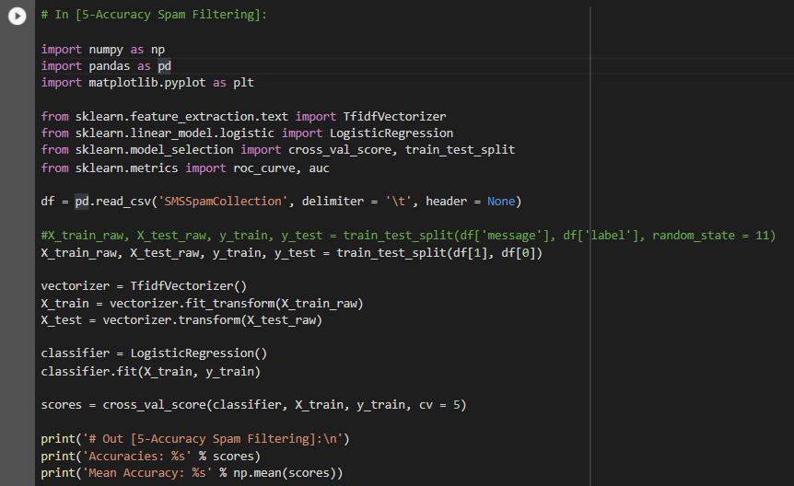

Accuracy

Slide 15

Precision, Recall, F1 Score – Another Approach
Manually changed: spam = 1, ham = 0.
Stored in new file: SmsSpam.txt

Slide 16
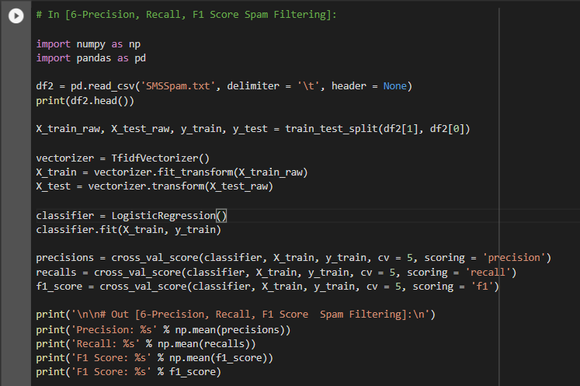
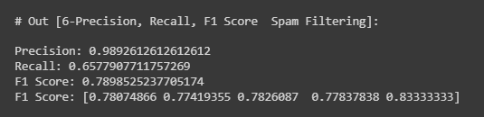
Precision, Recall, F1 Score

Slide 17
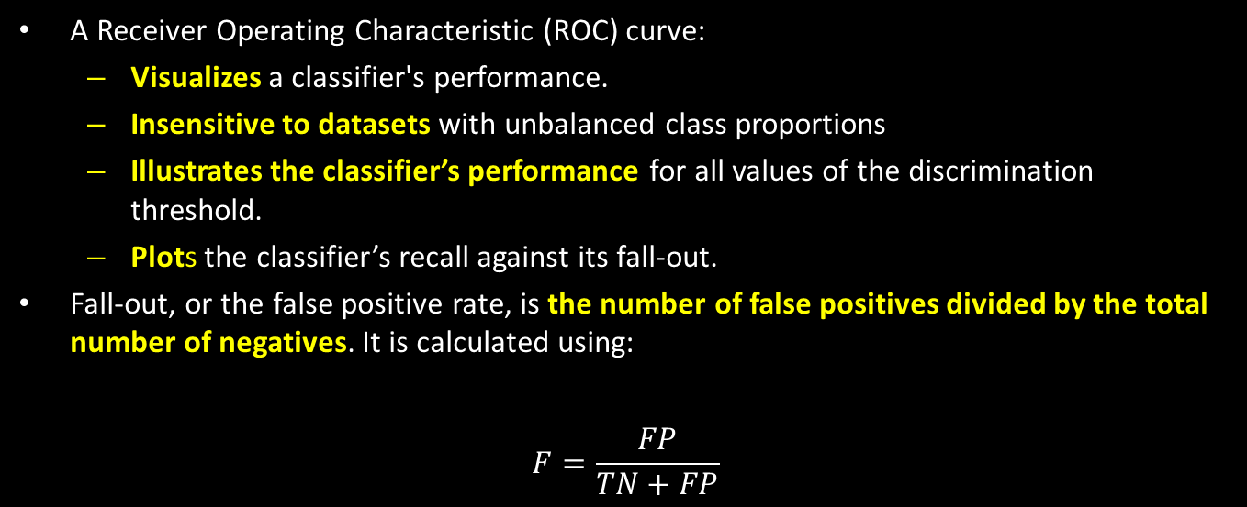
ROC AUC
A Receiver Operating Characteristic (ROC) curve:
Visualizes a classifier's performance.
Insensitive to datasets with unbalanced class proportions
Illustrates the classifier’s performance for all values of the discrimination threshold.
Plots the classifier’s recall against its fall-out.
Fall-out, or the false positive rate, is the number of false positives divided by the total number of negatives. It is calculated using:
$$F=\frac{FP}{TN+FP}$$

Slide 18
AUC
The area under the ROC curve.
The degree or measure of separability.
It reduces the ROC curve to a single value that represents the expected performance of the classifier.
The dashed line is for a classifier that predicts classes randomly.
The solid curve is for a classifier.

Slide 19
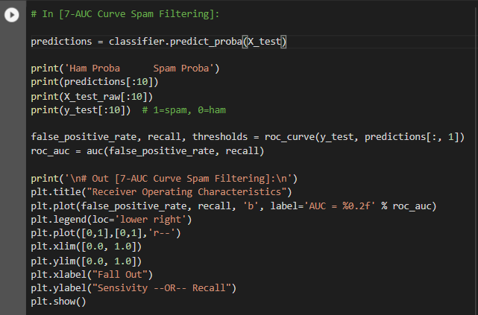
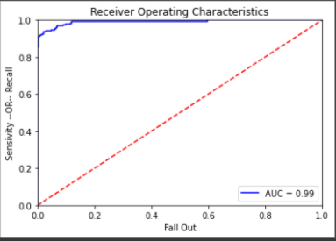
AUC for Spam Filtering

Slide 20
Tuning Model with Grid Search
Reminder – hyperparameters are parameters of the model that the learning algorithm does not estimate.
Grid search:
is a common method for selecting the hyperparameter values that produce the best model.
takes a set of possible values for each hyperparameter that should be tuned, and evaluates a model trained on each element of the Cartesian product of the sets.
is an exhaustive search that trains and evaluates a model for each possible combination of the specified hyperparameter values.

Slide 21
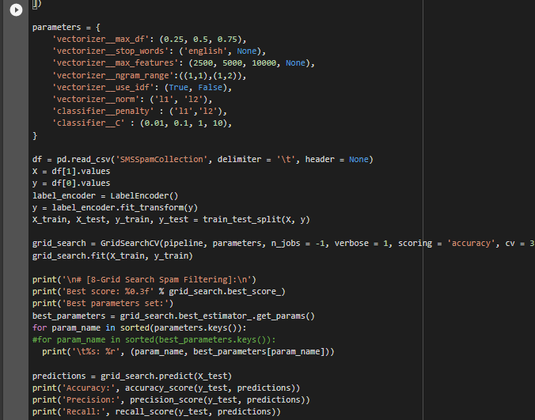
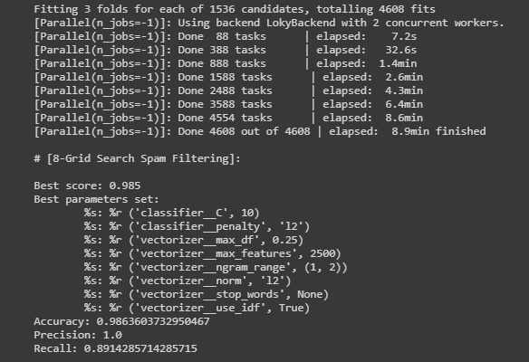
Tuning Model with Grid Search

Slide 22
Multi-class Classification
In many classification problems, however, there are more than two classes that are of interest.
The goal is to assign an instance to one of set of classes.
scikit-learn uses a strategy called one-versus-all, or one-versus-the-rest, to support multi-class classification.
One-versus-all classification uses one binary classifier for each of the possible classes.
The class that is predicted with the greatest confidence is assigned to the instance

Slide 23
Multi-label Classification and Problem Transformation
Each instance can be assigned a subset of the set of classes.
Problem transformation methods are techniques that cast the original multi-label problem as a set of single-label classification problems.

Slide 24
Problem Transformation
Technique 01 – Converts each set of labels encountered in the training data to a single label.
Technique 02 – To train one binary classifier for each of the labels in the training set.
Each classifier predicts whether or not the instance belongs to one label.
The final prediction is the union of the predictions from all of the binary classifiers.

Slide 25
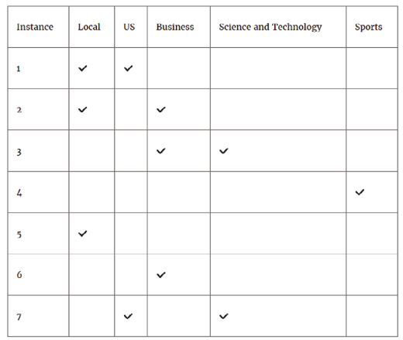
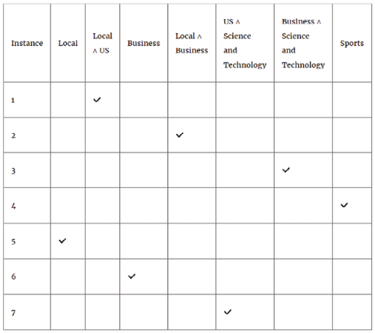
Technique 01

Slide 26
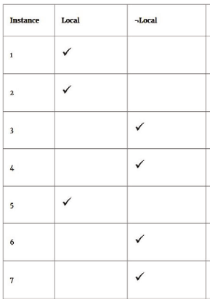
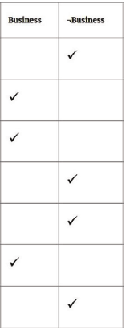
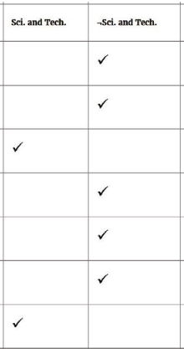
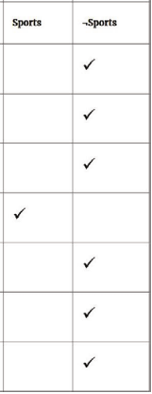
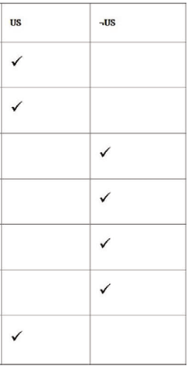
Technique 02
Binary Classifier 01
Binary Classifier 02
Binary Classifier 03
Binary Classifier 04
Binary Classifier 05

Slide 27

Multi-label Classification Performance Metrics
Must be assessed using different performance measures than single-label classification problems.
Two of the most common performance metrics are:
Hamming loss – the average fraction of incorrect labels. It is a loss function and that the perfect score is 0.
Jaccard similarity or the Jaccard index, is the size of the intersection of the predicted labels and the true labels divided by the size of the union of the predicted and true labels. It ranges from 0 to 1, and 1 is the perfect score.
$$J\left(Predicted, True\right)=\frac{\left|Predicted∩True\right|}{\left|Predicted∪True\right|}$$

Slide 28
Do Practices for Chapter 6

Slide 29
Thank You for Today
Always Keep Your Spirit!

